Slide 1
Process Management
CptS 360 Systems Programming
School of Electrical Engineering and Computer Science
Washington State University
Hassan Ghasemzadeh (hassan.ghasemzadeh@wsu.edu)

Slide 2
Multitasking
Multitasking is basis of all operating systems
It is also the basis of concurrent programming in general
What is multitasking?
The ability to performing multiple independent activities at the same time
For example, execution of several independent tasks at the same time by one or more CPUs
Uniprocessor (single CPU) systems
One task can execute at a time
Multitasking is achieved by multiplexing the CPU's execution time among different tasks
Switching the CPU’s execution from one task to another

Slide 3
Multitasking
Context switching in single-CPU systems
Switching executions among different tasks
Changes the execution environment of one task to that of another
If switching is fast enough, it gives the illusion that all the tasks are executing simultaneously
This logical parallelism is called concurrency
Multiprocessor systems
More than one CPU or processor cores
Tasks can execute on different CPUs in parallel
Each processor may also do multitasking

Slide 4
Process
An operating system is a multitasking system
In an operating system, tasks are also called processes.
A process is a program in execution
Process is the execution of a program image
Program becomes process when executable file loaded into memory
Process is a unit of work within system
Program is a passive entity, process is an active entity
One program can be several processes
Consider multiple users executing the same program

Slide 5
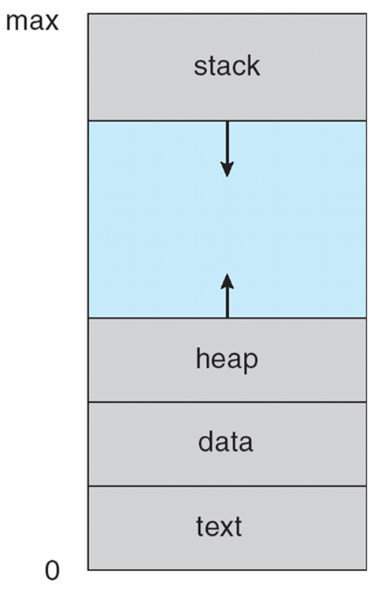
Process in memory
Status of current activity of a process is represented by program counter and contents of processor's registers.
Memory layout of a process
Text section: the executable code
Data section: global variables
Heap section: memory dynamically allocated during program run time
Stack section: temporary data storage when invoking functions
Note:
sizes of text and data sections are fixed, not changing during program run time.
stack and heap sections can shrink and grow dynamically during program execution.

Slide 6
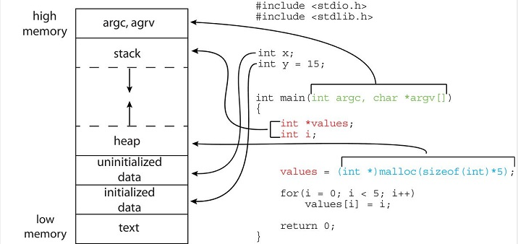
Process memory layout example
Global data section is divided into different sections for initialized data and uninitialized data.
A separate section is provided for the argc and argv parameters passed to the main() function.
The data field refers to uninitialized data, and bss refers to initialized data

Slide 7
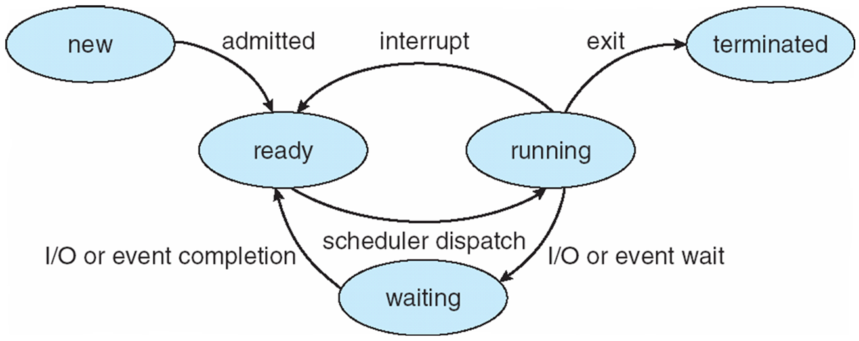
Process state
As a process executes, it changes state
new: process is being created
running: instructions are being executed
waiting: process is waiting for some event to occur
ready: process is waiting to be assigned to a processor
terminated: process has finished execution
Notes: these names are arbitrary, and they vary across operating systems

Slide 8
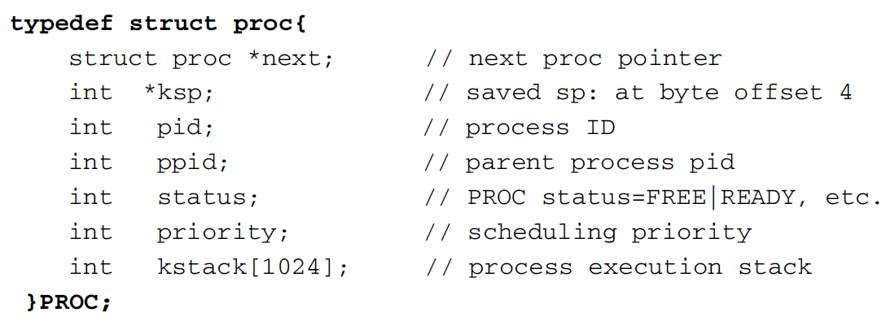
Process data structure
Process needs resources to accomplish its task
CPU, memory, I/O, files
Initialization data
PROC structure
Each process is represented by a unique data structure, called the Process Control Block (PCB) or Task Control Block (TCB)
A simple PROC may look like this:

Slide 9
PROC structure
In PROC structure
next: pointer to the next PROC structure
Used to maintain processes of the system in a dynamic data structures such as linked lists and queues
ksp: saved stack pointer
When a process gives up the CPU, it saves the execution context in stack and saves the stack pointer in PROC.ksp for resumption later
pid: process ID number
ppid: parent process ID number
status: current status of the process
priority: scheduling priority
kstack: process stack when it is executing

Slide 10
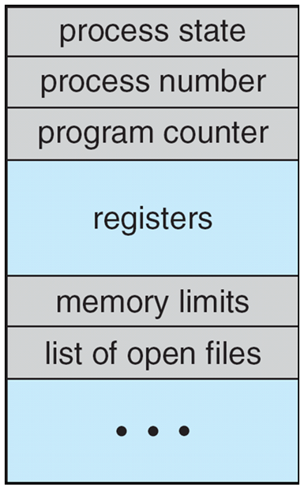
Process Control Block (PCB)
A more general representation of PCB contains the following information:
Process state: running, waiting, etc
Program counter: location of instruction to next execute
CPU registers: contents of all process-centric registers
CPU scheduling information: priorities, scheduling queue pointers
Memory-management information: memory allocated to the process
Accounting information: CPU used, clock time elapsed since start, time limits
I/O status information: I/O devices allocated to process, list of open files

Slide 11
Maintaining PROC structure
An OS kernel usually defines a finite number of PROC structures in its data area, denoted by
In single CPU systems
Kernel uses a global PROC pointer, running or current, to point at the PROC that is currently executing
In multiprocessor systems
running[NCPU] may be an array of pointers, each pointing at a PROC running on a specific CPU
For simplicity, we only consider single CPU systems.

Slide 12
Context Switch
Interrupts cause the operating system to change a CPU core from its current task and to run a kernel routine
Such operations happen frequently on general-purpose systems
When an interrupt occurs, system needs to save the current context of the process running on CPU core
The context is represented in the PCB of the process
Generically, we perform a state save of current state of CPU core, and then a state restore to resume operations

Slide 13
What happens upon context switching?
When a context switch occurs
kernel saves the context of the old process in its PCB
kernel loads the saved context of the new process scheduled to run
Context-switch time is pure overhead, because the system does no useful work while switching
Switching speed varies from machine to machine, depending on the memory speed, the number of registers that must be copied, and the existence of special instructions (such as a single instruction to load or store all registers)
A typical speed is a several microseconds.

Slide 14
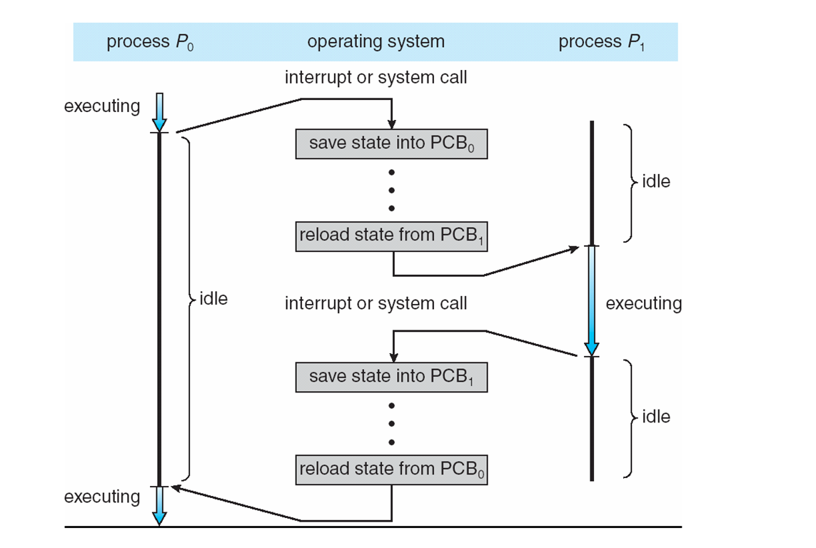
CPU switch from one process to another

